Slide 1
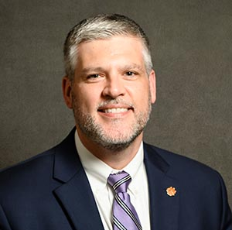
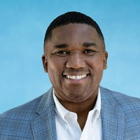
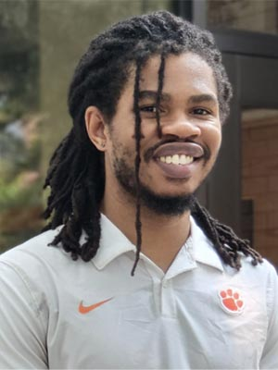
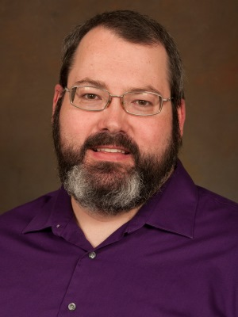
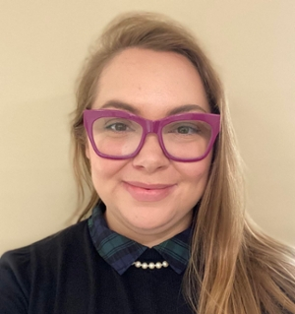
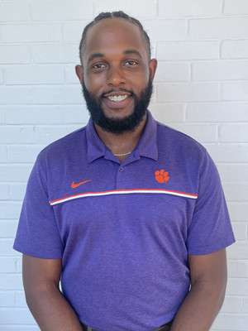
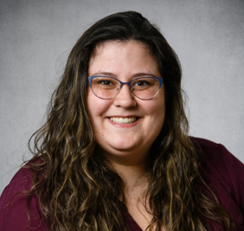
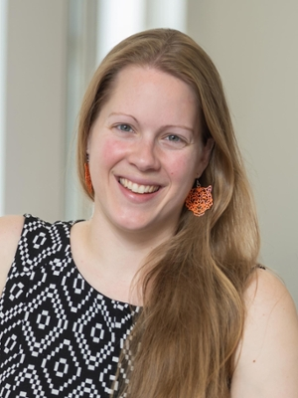
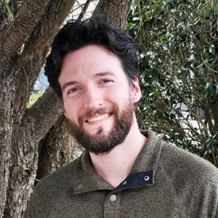
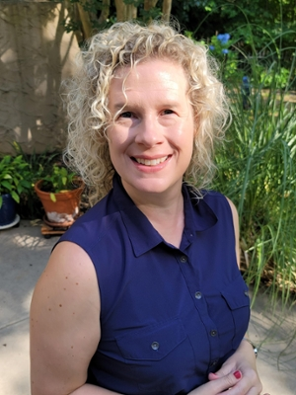
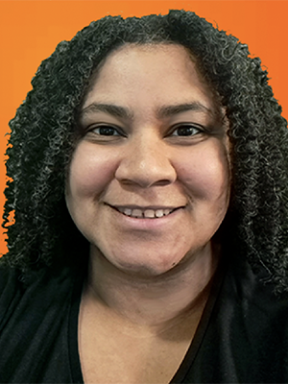
Advancement Technology
Chief Technology Officer
Tim Jones
Information Security
Luther Hill, Director
Advancement IT
Tenneil Moody, Director
Technical Services
Darius, Director
Programmer, Technical Lead,
James Huff
Sr. Business Analyst
Mary Frances Csernak, Lead
Service Desk Specialist
Logan Wade
Programmer & Systems Analyst
Vivian Bennae
Business Analyst
Karmen Sutton
Service Desk, Student
Jones Hall
Programmer & Systems Analyst
Caleb Hilley
Analyst, Part Time
Noelle Whitener
Service Desk, Student
Endia Rogers
Digital Fund. Analyst
Heather Dromm
Program Developer
America Murray

